Slide 1
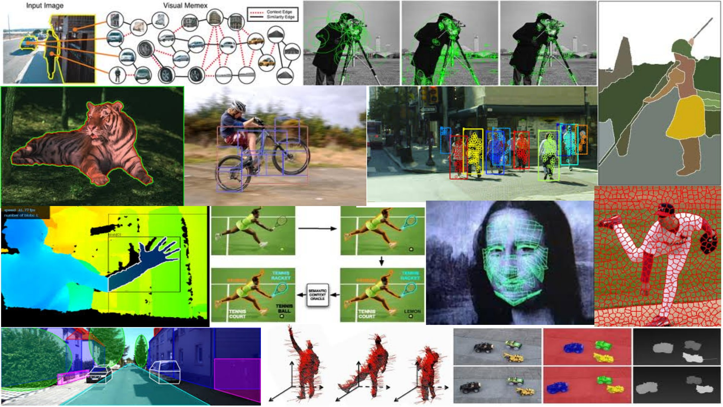
Edges and Binary Image Analysis April 12th, 2018
Yong Jae Lee
UC Davis

Slide 2
Previously
Filters allow local image neighborhood to influence our description and features
Smoothing to reduce noise
Derivatives to locate contrast, gradient
Seam carving application:
use image gradients to measure “interestingness” or “energy”
remove 8-connected seams so as to preserve image’s energy

Slide 3
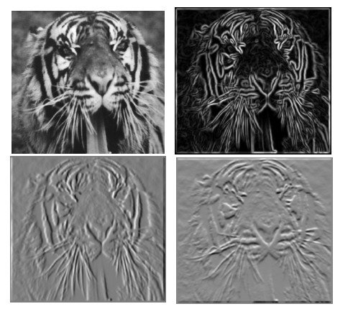
Review: Partial derivatives of an image
?
-1 1
1 -1
-1 1
or
Which shows changes with respect to x?
3
Slide credit: Kristen Grauman
(showing filters for correlation)

Slide 4


0
255
-1 1
0
(showing filters for correlation)

Slide 5


0
255
-1 1
1 -1
255
0
-255
(showing filters for correlation)

Slide 6
Today
Edge detection and matching
process the image gradient to find curves/contours
comparing contours
Binary image analysis
blobs and regions

Slide 7
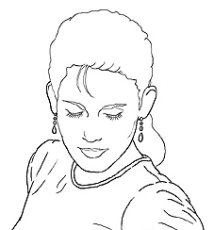
Edge detection
Goal: map image from 2d array of pixels to a set of curves or line segments or contours.
Why?
Main idea: look for strong gradients, post-process
Figure from J. Shotton et al., PAMI 2007
Figure from D. Lowe
Slide credit: Kristen Grauman

Slide 8
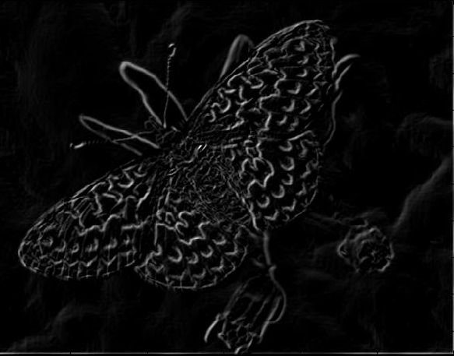
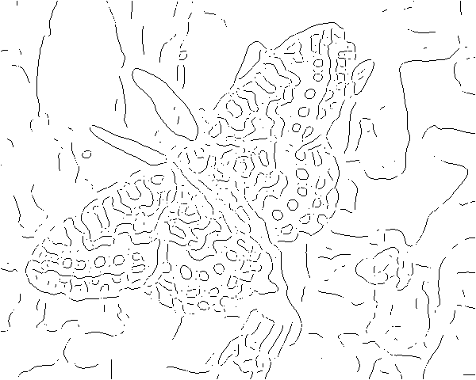
Gradients -> edges
Primary edge detection steps:
1. Smoothing: suppress noise
2. Edge enhancement: filter for contrast
3. Edge localization
Determine which local maxima from filter output are actually edges vs. noise
Threshold, Thin
Slide credit: Kristen Grauman

Slide 9
Thresholding
Choose a threshold value t
Set any pixels less than t to zero (off)
Set any pixels greater than or equal to t to one (on)
Slide credit: Kristen Grauman

Slide 10
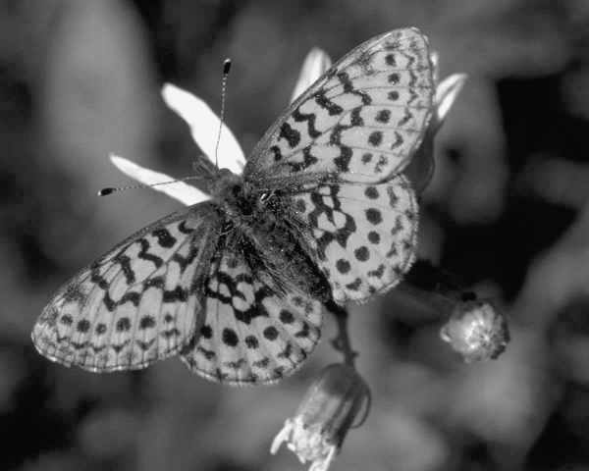
Original image
Slide credit: Kristen Grauman

Slide 11
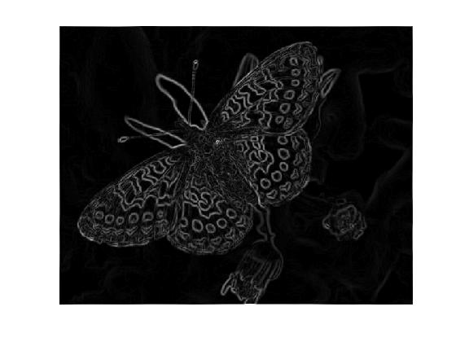
Gradient magnitude image

Slide 12
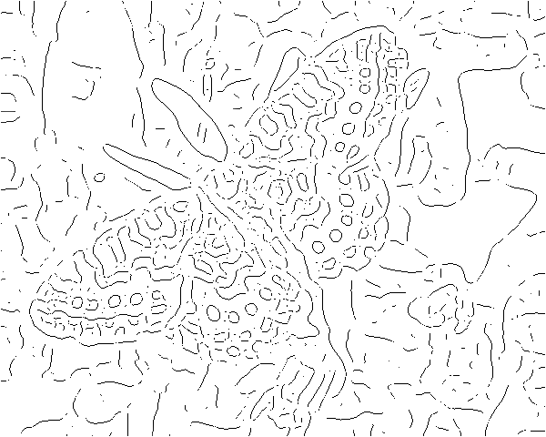
Thresholding gradient with a lower threshold
Slide credit: Kristen Grauman

Slide 13
Thresholding gradient with a higher threshold
Slide credit: Kristen Grauman

Slide 14
Canny edge detector
Filter image with derivative of Gaussian
Find magnitude and orientation of gradient
Non-maximum suppression:
Thin wide “ridges” down to single pixel width
Linking and thresholding (hysteresis):
Define two thresholds: low and high
Use the high threshold to start edge curves and the low threshold to continue them
MATLAB: edge(image, ‘canny’);
>>help edge
Slide credit: David Lowe, Fei-Fei Li

Slide 15

The Canny edge detector
original image (Lena)
Slide credit: Steve Seitz

Slide 16
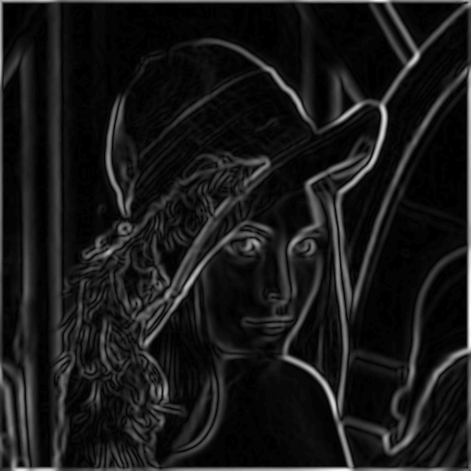
The Canny edge detector
gradient magnitude
Slide credit: Kristen Grauman

Slide 17
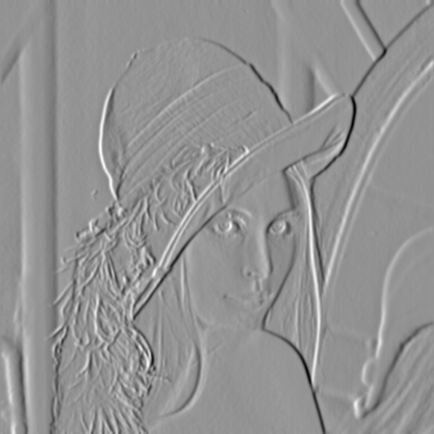
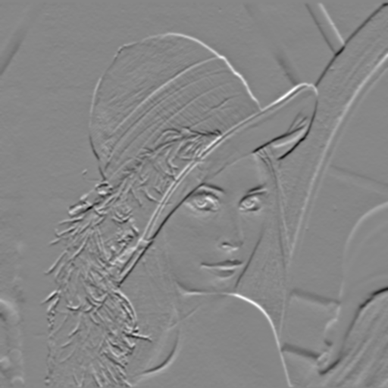
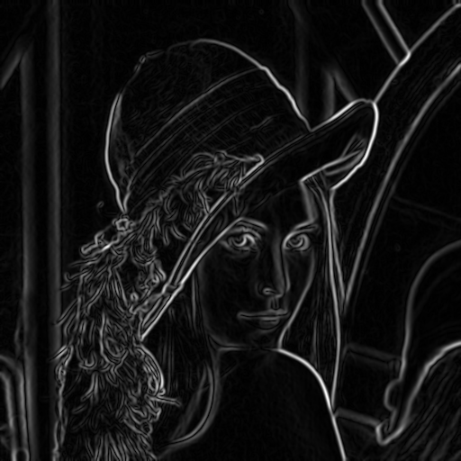
Compute Gradients
X-Derivative of Gaussian
Y-Derivative of Gaussian
Gradient Magnitude
Slide credit: Svetlana Lazebnik

Slide 18
The Canny edge detector
gradient magnitude
Slide credit: Kristen Grauman

Slide 19
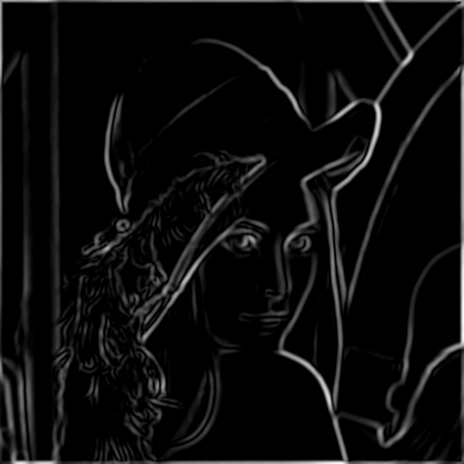
The Canny edge detector
thresholding
Slide credit: Kristen Grauman

Slide 20
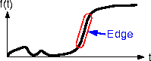
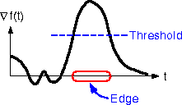
The Canny edge detector
How to turn these thick regions of the gradient into curves?
thresholding
Slide credit: Kristen Grauman

Slide 21

Non-maximum suppression
Check if pixel is local maximum along gradient direction
Select single max across width of the edge
Requires checking interpolated pixels p and r
Slide credit: Kristen Grauman

Slide 22
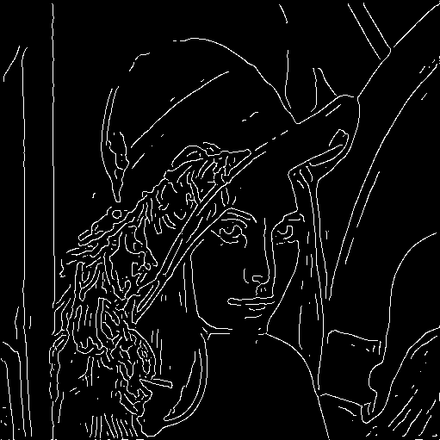
The Canny edge detector
Problem: pixels along this edge didn’t survive the thresholding
thinning
(non-maximum suppression)
Slide credit: Kristen Grauman

Slide 23
Hysteresis thresholding
Use a high threshold to start edge curves, and a low threshold to continue them.
Slide credit: Steve Seitz

Slide 24
Hysteresis thresholding
original image
high threshold
(strong edges)
low threshold
(weak edges)
hysteresis threshold
Slide credit: Fei-Fei Li

Slide 25
Hysteresis thresholding
http://users.ecs.soton.ac.uk/msn/book/new_demo/thresholding/

Slide 26
Recap: Canny edge detector
Filter image with derivative of Gaussian
Find magnitude and orientation of gradient
Non-maximum suppression:
Thin wide “ridges” down to single pixel width
Linking and thresholding (hysteresis):
Define two thresholds: low and high
Use the high threshold to start edge curves and the low threshold to continue them
MATLAB: edge(image, ‘canny’);
>>help edge
Slide credit: David Lowe, Fei-Fei Li

Slide 27
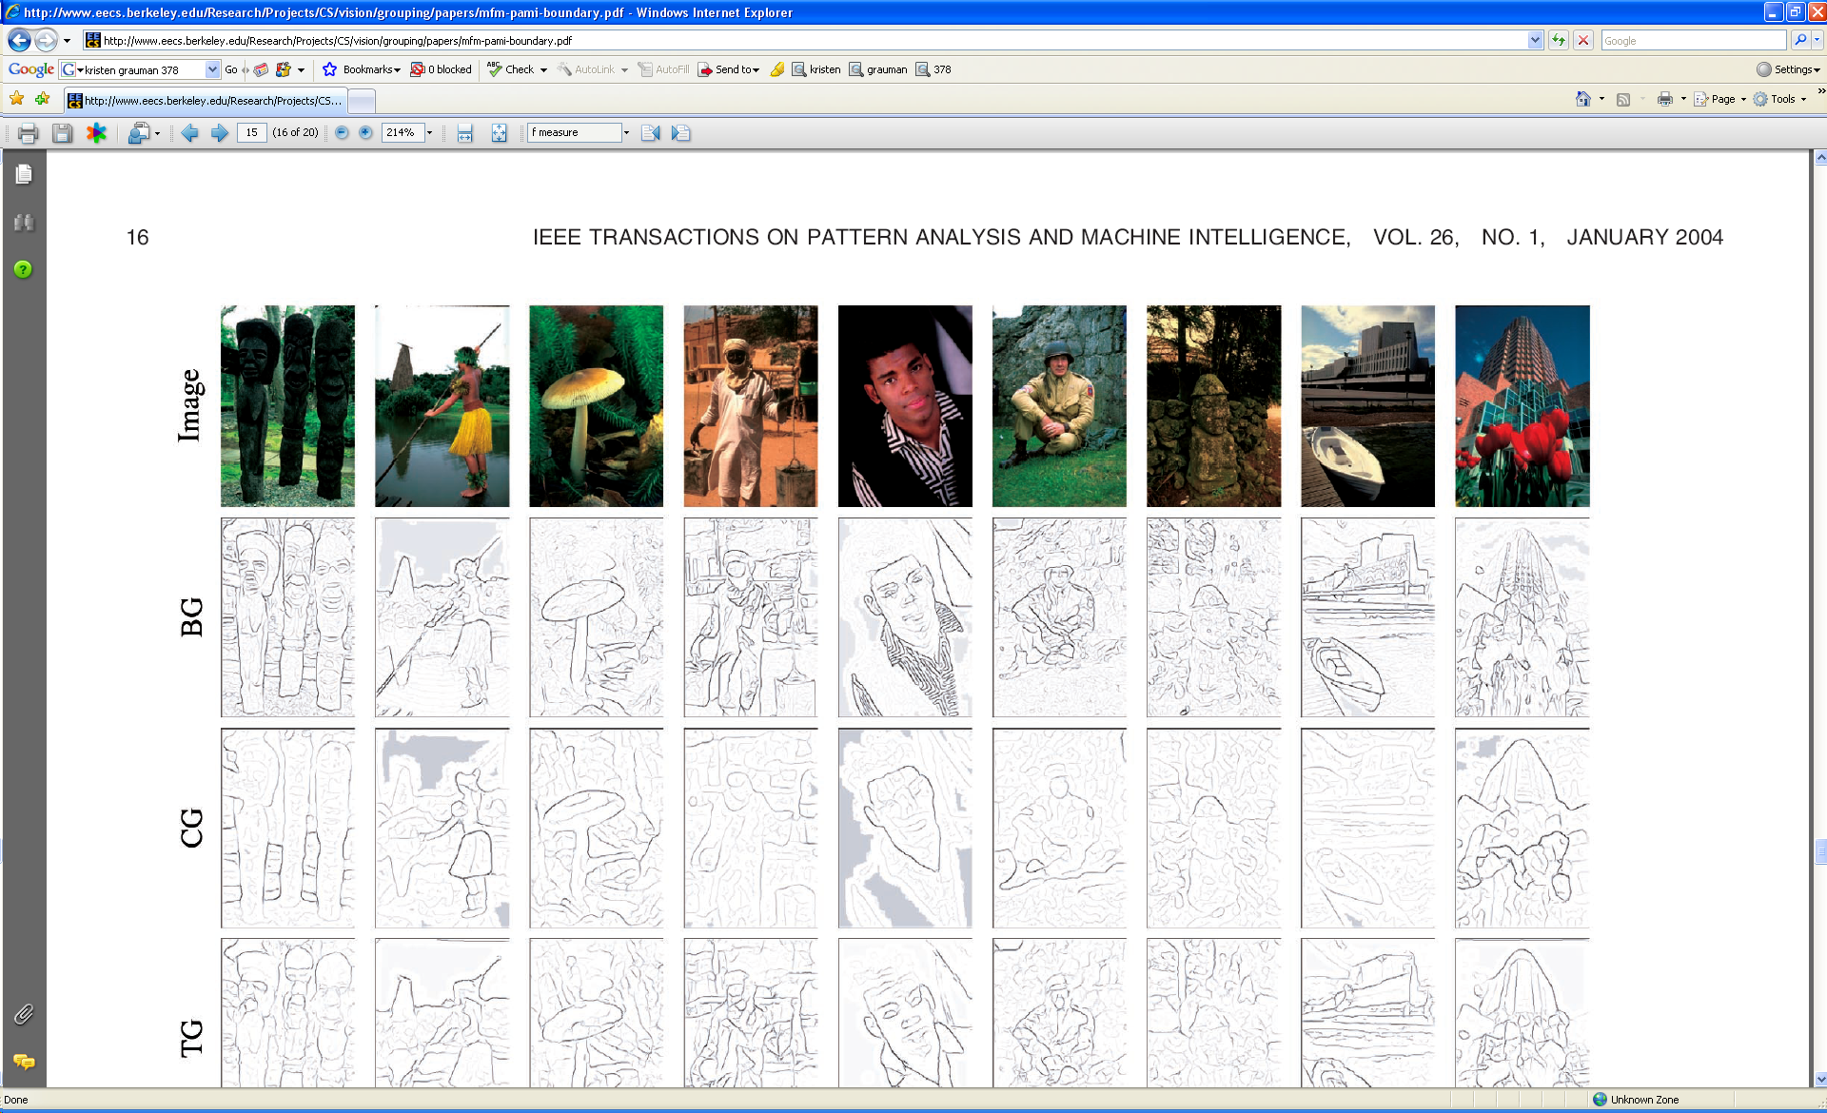
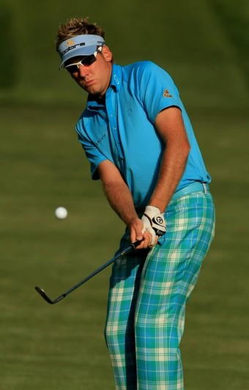
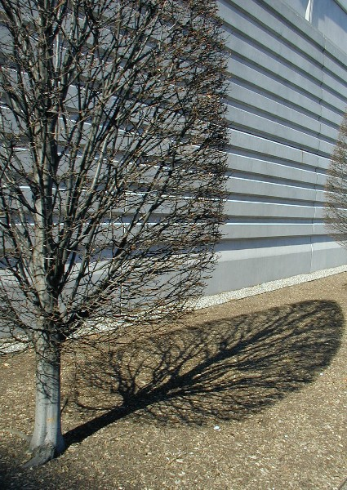

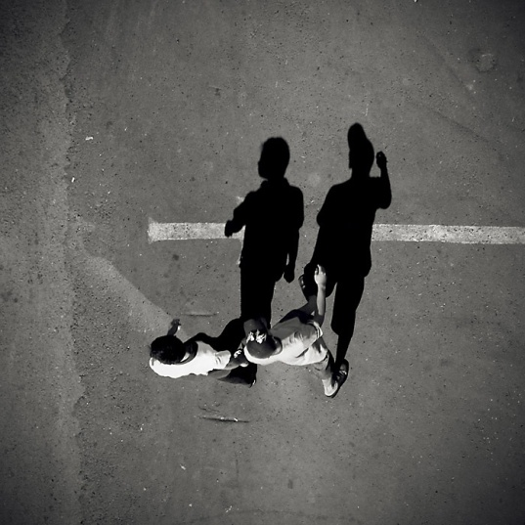
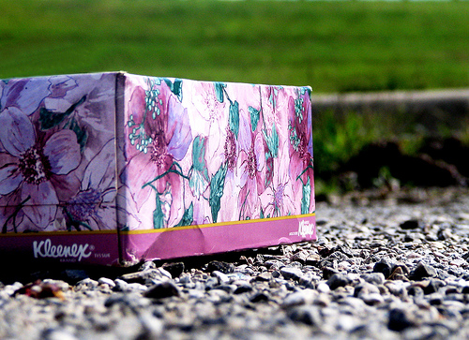
Low-level edges vs. perceived contours
Background
Texture
Shadows
Slide credit: Kristen Grauman

Slide 28
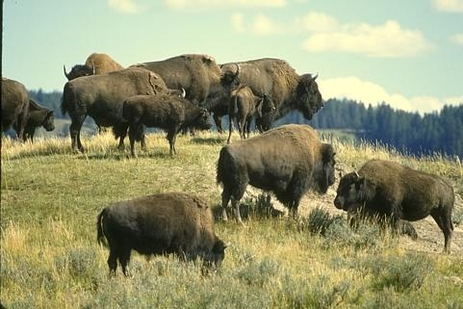
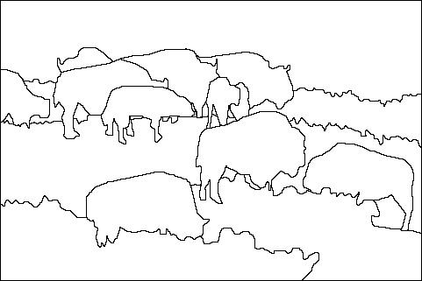
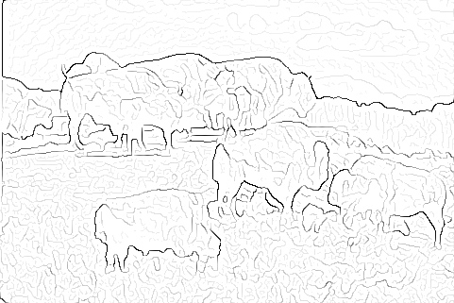
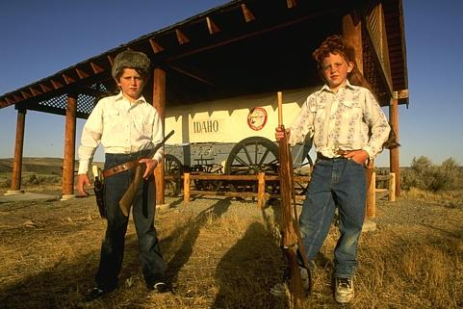
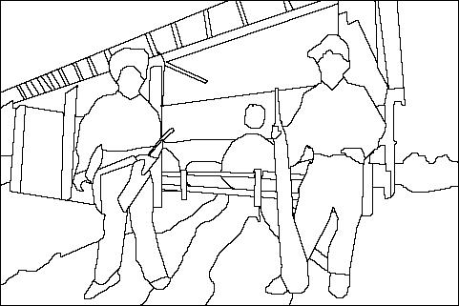
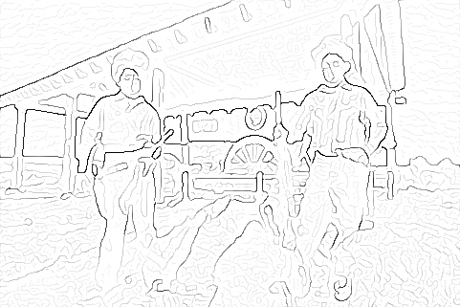
Low-level edges vs. perceived contours
image
human segmentation
gradient magnitude
Berkeley segmentation database: http://www.eecs.berkeley.edu/Research/Projects/CS/vision/grouping/segbench/
Slide credit: Svetlana Lazebnik

Slide 29
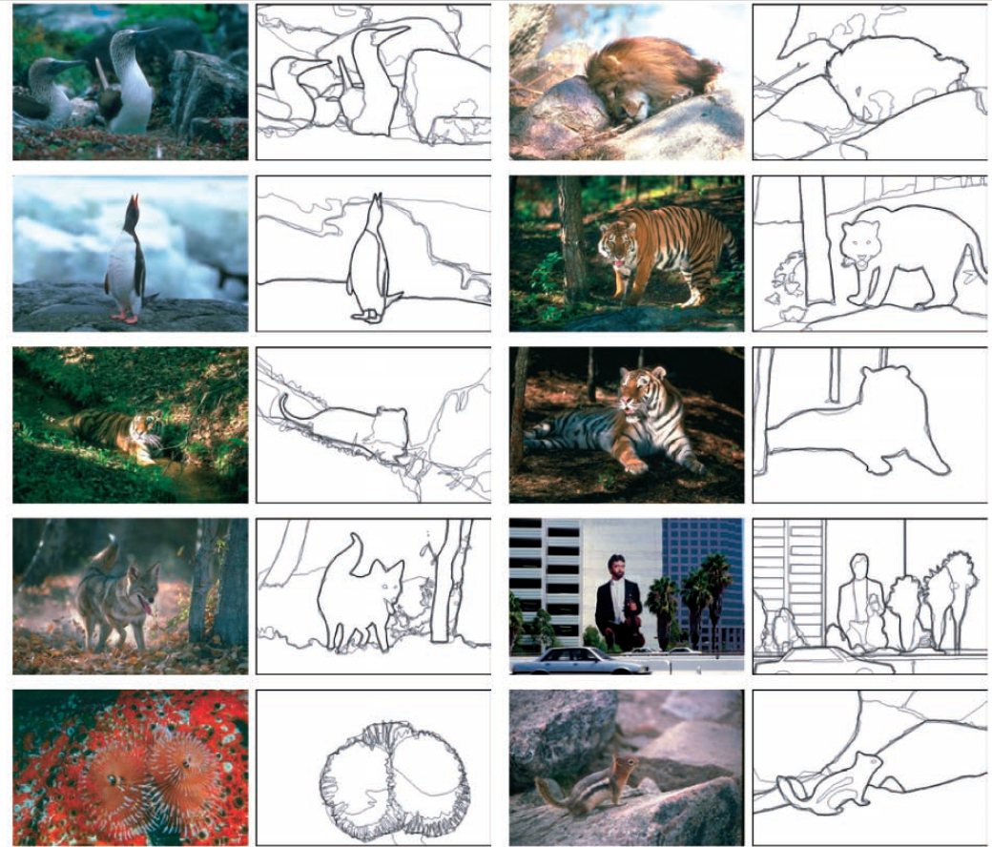
Learn from humans which combination of features is most indicative of a “good” contour?
[D. Martin et al. PAMI 2004]
Human-marked segment boundaries
Slide credit: Kristen Grauman

Slide 30
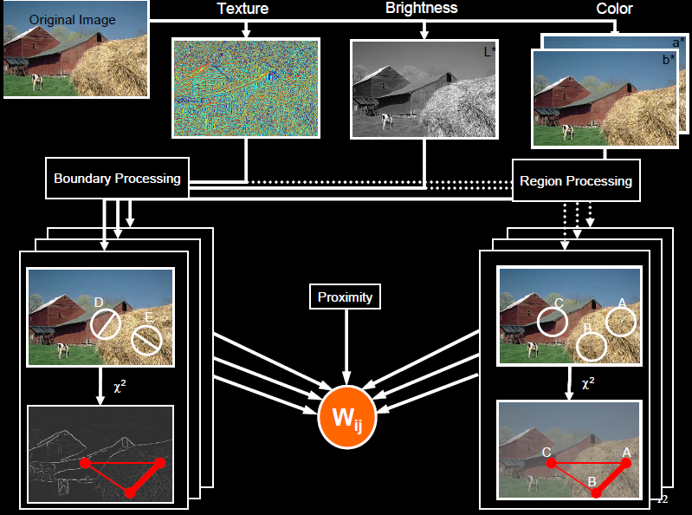
pB boundary detector
Martin, Fowlkes, Malik 2004: Learning to Detection Natural Boundaries…
http://www.eecs.berkeley.edu/Research/Projects/CS/vision/grouping/papers/mfm-pami-boundary.pdf
Figure from Fowlkes

Slide 31
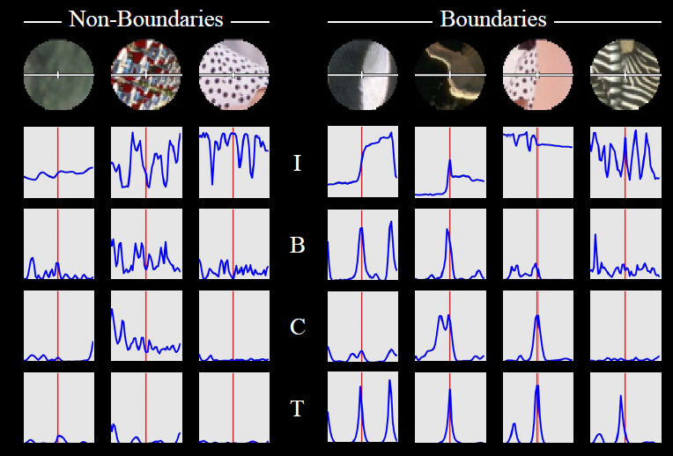
pB Boundary Detector
Figure from Fowlkes

Slide 32
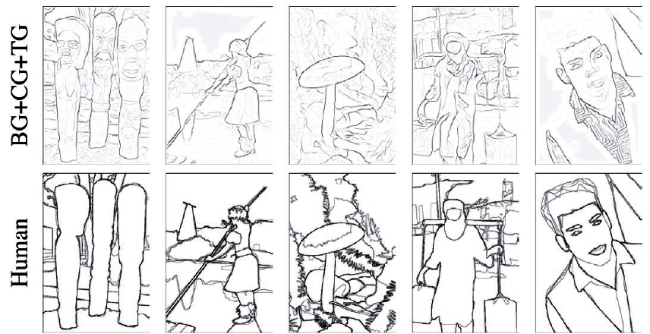
Slide credit: Kristen Grauman
[D. Martin et al. PAMI 2004]

Slide 33
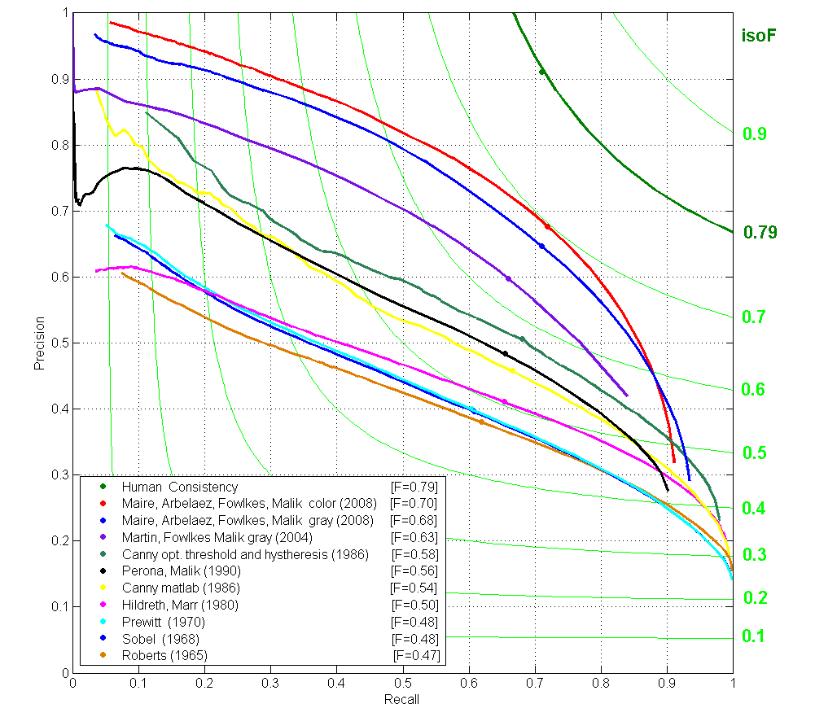
State-of-the-Art in Contour Detection
Canny+opt thresholds
Human agreement
Canny
Prewitt, Sobel, Roberts
pB
Source: Jitendra Malik: http://www.cs.berkeley.edu/~malik/malik-talks-ptrs.html

Slide 34
Holistically-Nested Edge Detection (Xie, Tu ICCV 2015)
holistic image training and prediction
multi-scale and multi-level feature learning
Deeply-supervised fully-convolutional network

Slide 35
State-of-the-Art in Contour Detection
HED
pB

Slide 36
Today
Edge detection and matching
process the image gradient to find curves/contours
comparing contours
Binary image analysis
blobs and regions
Slide credit: Kristen Grauman

Slide 37
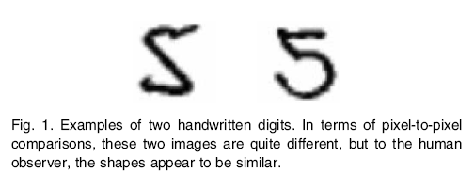
Figure from Belongie et al.

Slide 38
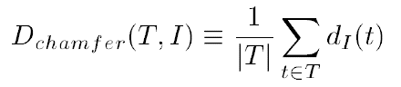
Chamfer distance
Average distance to nearest feature/edge
Set of edge points in image
Set of edge points on (shifted) template
Minimum distance between point t and some point in I

Slide 39
Chamfer distance
Slide credit: Kristen Grauman

Slide 40
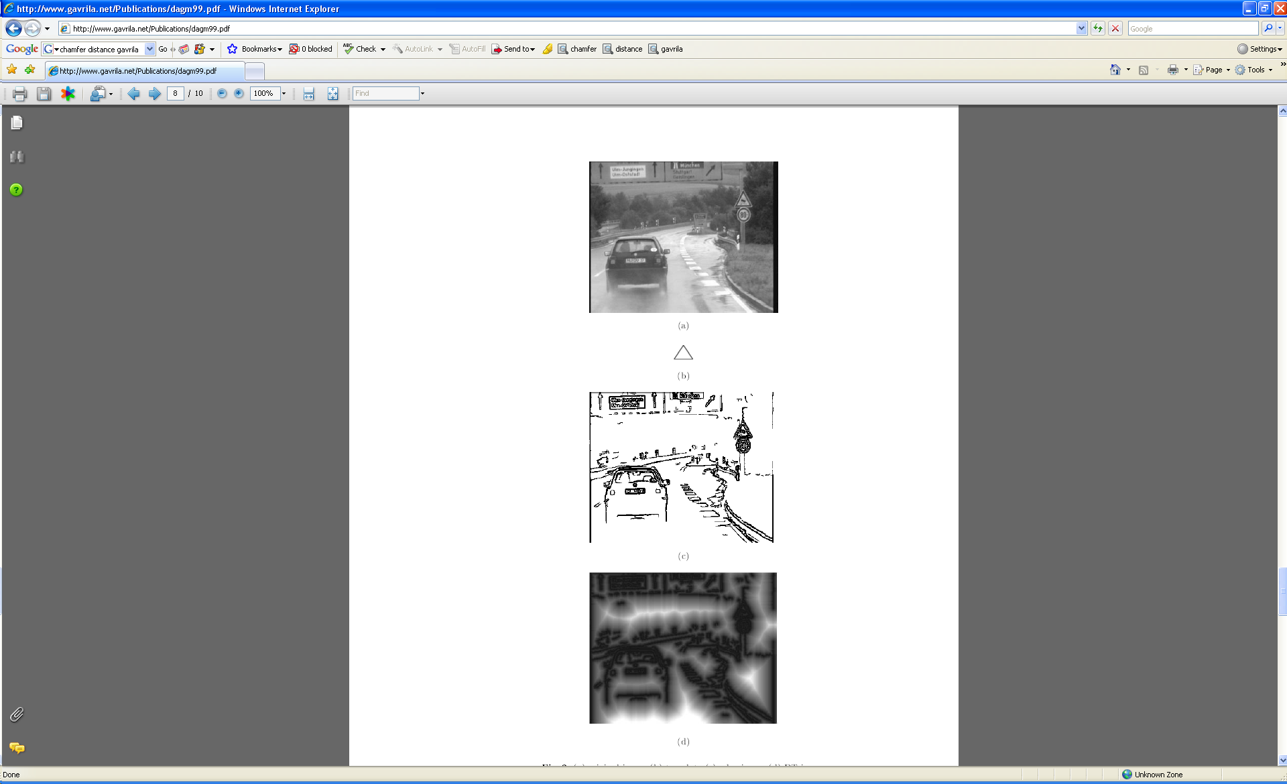
Chamfer distance
Average distance to nearest feature
How is the measure different than just filtering with a mask having the shape points?
How expensive is a naïve implementation?
Edge image
Slide credit: Kristen Grauman
Notes:
Looking at distances from template points to closest edge.
Naïve: k * p (k = number of template points, p = number of edge points) at each location.

Slide 41
Distance transform
Image features (2D)
Distance Transform
1
0
1
2
3
4
3
2
1
0
1
2
3
3
2
1
1
0
1
2
3
2
1
0
1
0
0
1
2
1
0
1
2
1
1
2
1
0
1
2
3
2
2
2
1
0
1
2
4
3
3
2
1
0
1
2
5
4
4
3
2
1
0
1
Distance Transform is a function that for each image pixel p assigns a non-negative number corresponding to distance from p to the nearest feature in the image I
Slide credit: Yuri Boykov

Slide 42

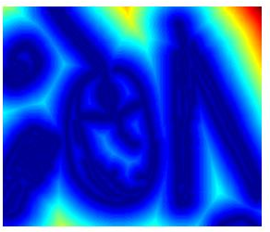

Distance transform
original
edges
distance transform
Value at (x,y) tells how far that position is from the nearest edge point (or other binary image structure)
>> help bwdist
Slide credit: Kristen Grauman

Slide 43
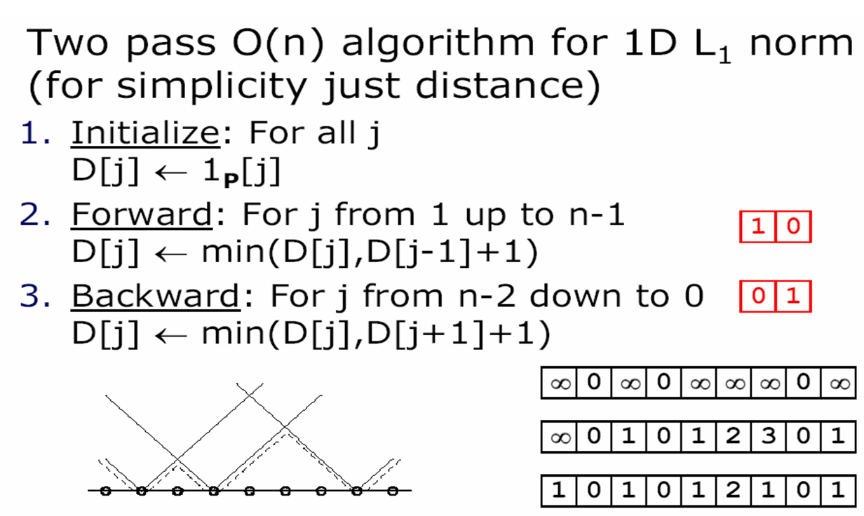
Distance transform (1D)
// 0 if j is in P, infinity otherwise
Image features (edges)
0 | 1 | 0 | 1 | 0 | 0 | 0 | 1 | 0
Distance transform
Slide adapted from Dan Huttonlocher

Slide 44
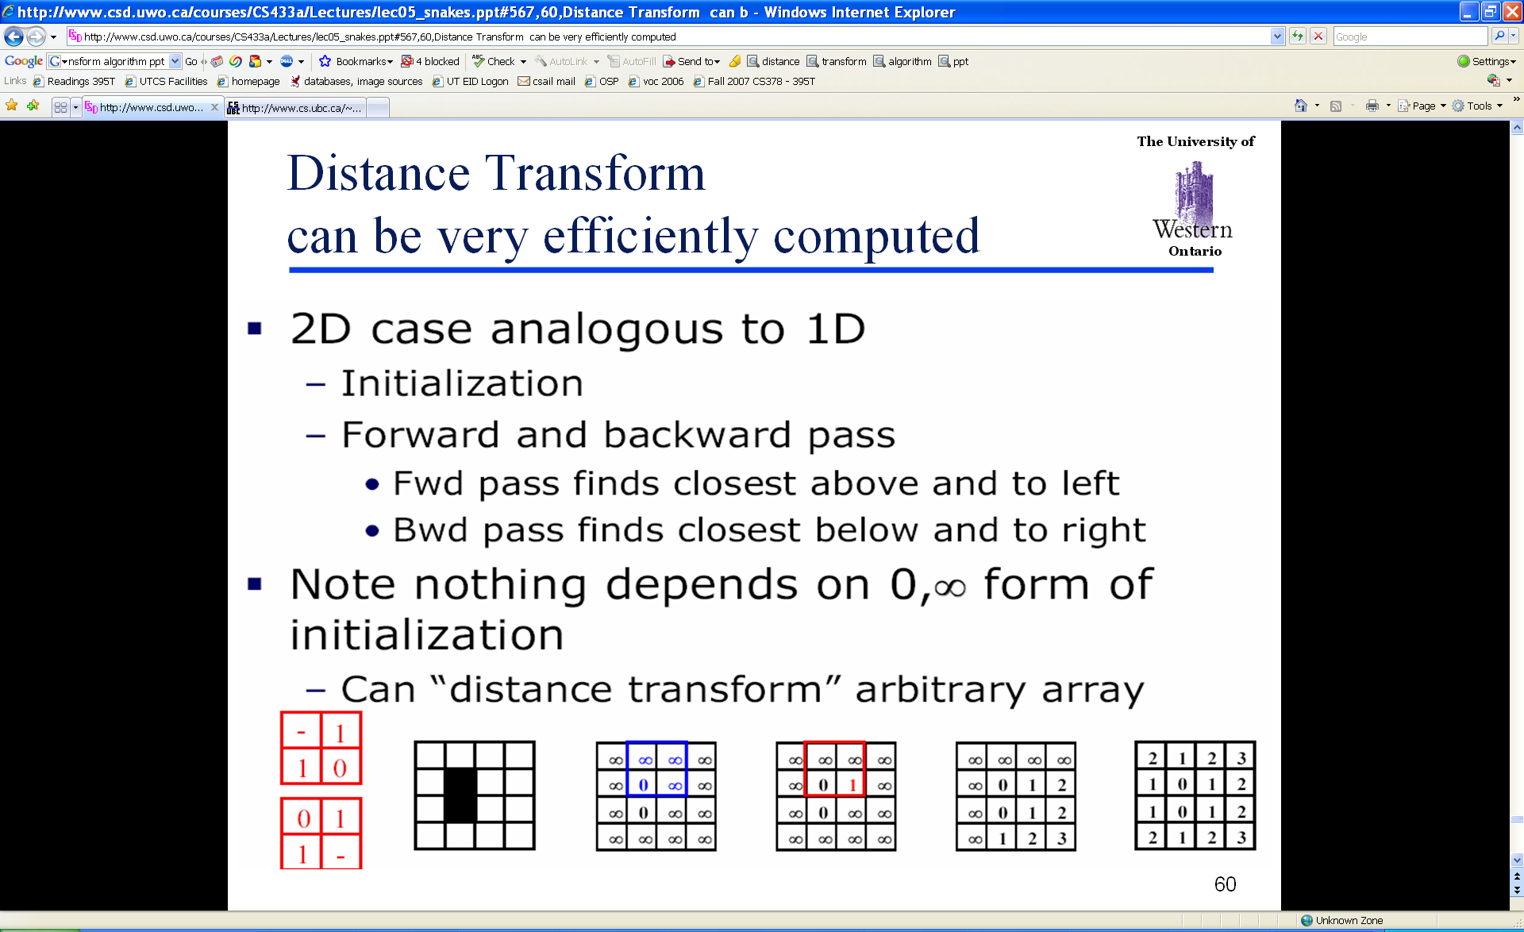
Distance Transform (2D)
Slide credit: Dan Huttonlocher

Slide 45
Chamfer distance
Average distance to nearest feature
Edge image
Distance transform image
Slide credit: Kristen Grauman

Slide 46
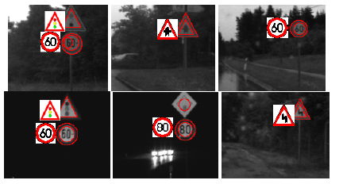
Chamfer distance
Edge image
Distance transform image
Fig from D. Gavrila, DAGM 1999

Slide 47
Chamfer distance: properties
Sensitive to scale and rotation
Tolerant of small shape changes, clutter
Need large number of template shapes
Inexpensive way to match shapes
Slide credit: Kristen Grauman

Slide 48
Today
Edge detection and matching
process the image gradient to find curves/contours
comparing contours
Binary image analysis
blobs and regions
Slide credit: Kristen Grauman

Slide 49
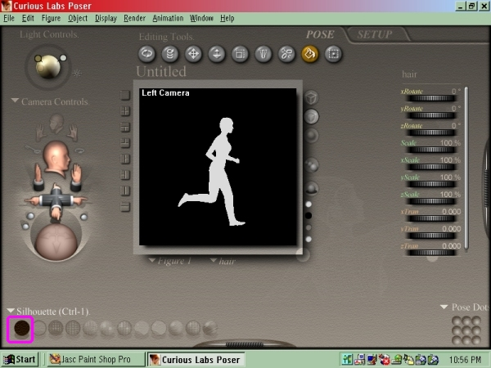
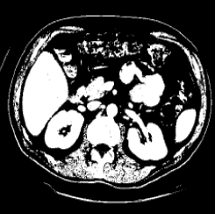
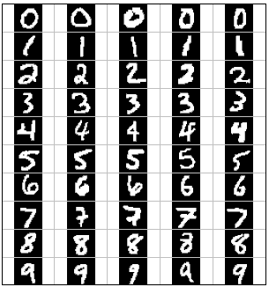
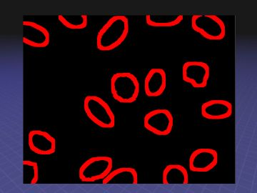
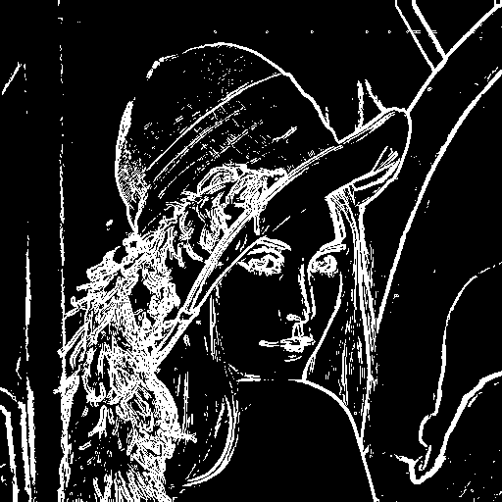
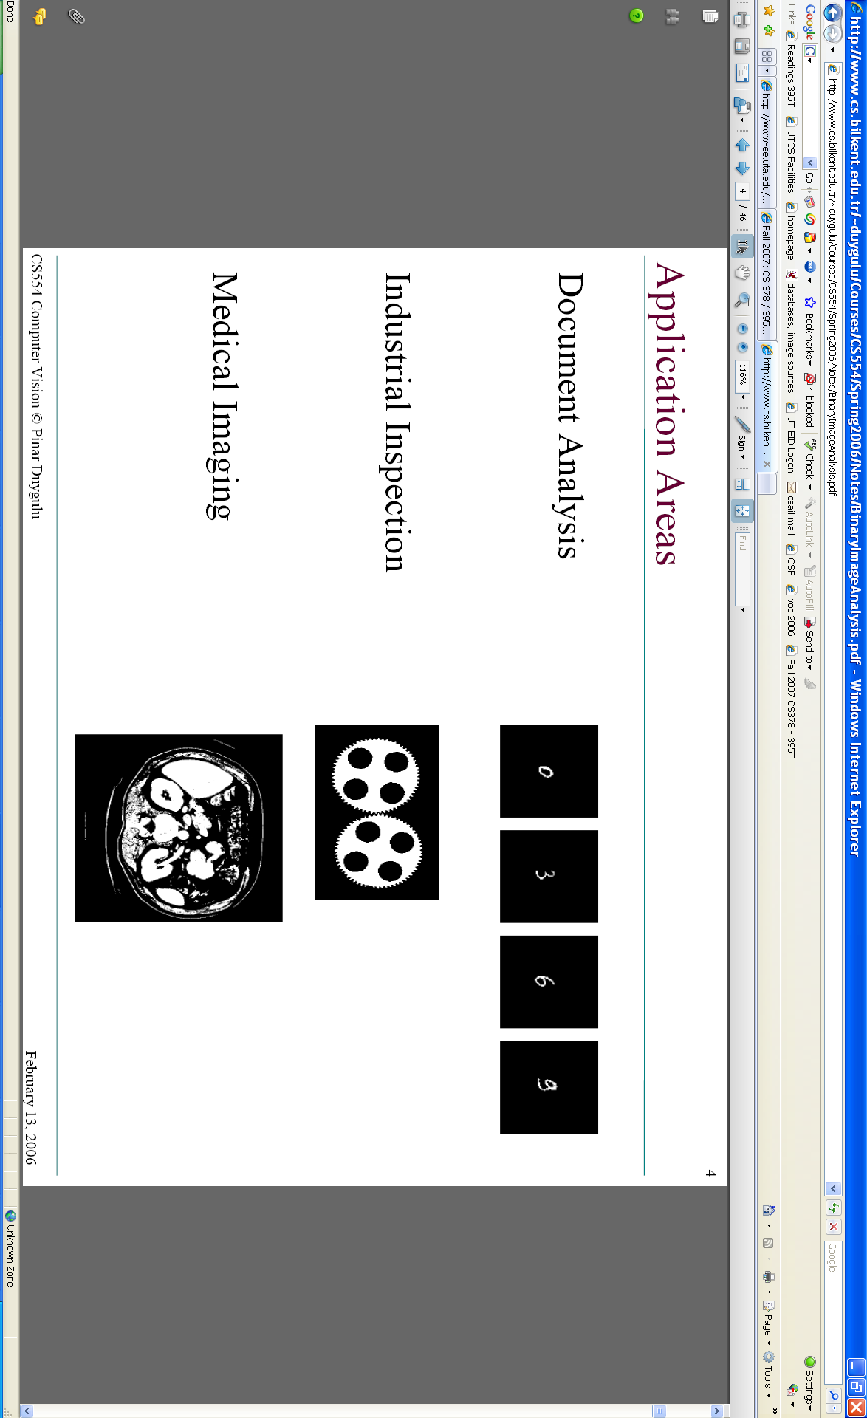
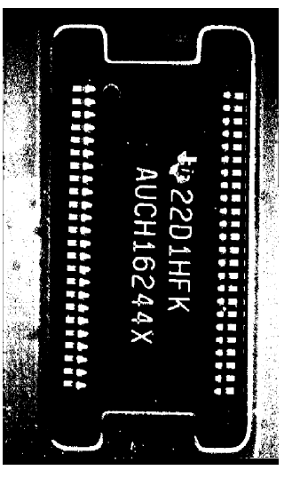
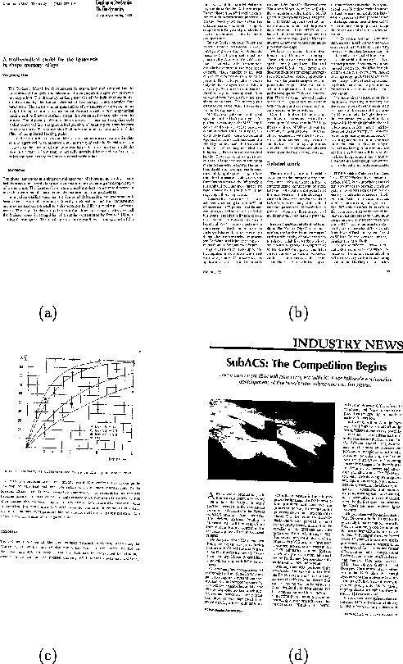
Binary images
Slide credit: Kristen Grauman

Slide 50
Binary image analysis: basic steps
Convert the image into binary form
Thresholding
Clean up the thresholded image
Morphological operators
Extract separate blobs
Connected components
Describe the blobs with region properties
Slide credit: Kristen Grauman

Slide 51
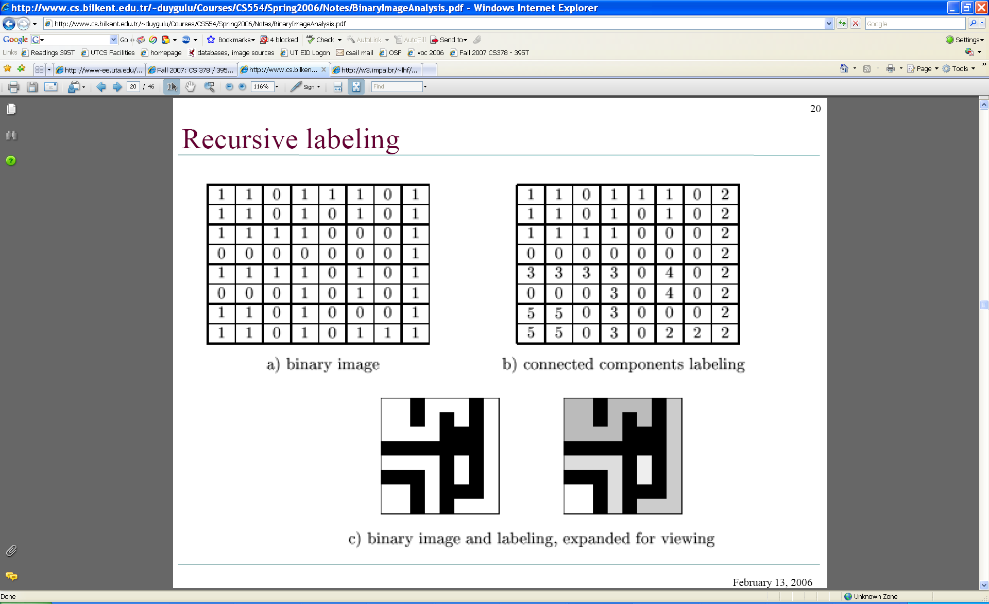
Binary images
Two pixel values
Foreground and background
Mark region(s) of interest
Slide credit: Kristen Grauman

Slide 52
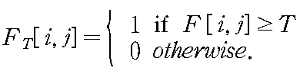
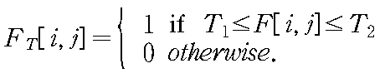

Thresholding
Grayscale -> binary mask
Useful if object of interest’s intensity distribution is distinct from background
Example http://homepages.inf.ed.ac.uk/rbf/CVonline/LOCAL_COPIES/FITZGIBBON/simplebinary.html
Slide credit: Kristen Grauman

Slide 53
Thresholding
Given a grayscale image or an intermediate matrix → threshold to create a binary output.
Example: edge detection
Gradient magnitude
fg_pix = find(gradient_mag > t);
Looking for pixels where gradient is strong.
Slide adapted from Kristen Grauman

Slide 54




Thresholding
Given a grayscale image or an intermediate matrix → threshold to create a binary output.
Example: background subtraction
-
=
Looking for pixels that differ significantly from the “empty” background.
Slide credit: Kristen Grauman
fg_pix = find(diff > t);

Slide 55


Thresholding
Given a grayscale image or an intermediate matrix → threshold to create a binary output.
Example: intensity-based detection
fg_pix = find(im < 65);
Looking for dark pixels
Slide credit: Kristen Grauman

Slide 56


Thresholding
Given a grayscale image or an intermediate matrix → threshold to create a binary output.
Example: color-based detection
fg_pix = find(hue > t1 & hue < t2);
Looking for pixels within a certain hue range.
Slide credit: Kristen Grauman

Slide 57

A nice case: bimodal intensity histograms
Ideal histogram, light object on dark background
Actual observed histogram with noise
Images: http://homepages.inf.ed.ac.uk/rbf/CVonline/LOCAL_COPIES/OWENS/LECT2/node3.html

Slide 58


Not so nice cases
Slide credit: Shapiro and Stockman

Slide 59
Issues
What to do with “noisy” binary outputs?
Holes
Extra small fragments
How to demarcate multiple regions of interest?
Count objects
Compute further features per object
Slide credit: Kristen Grauman

Slide 60
Morphological operators
Change the shape of the foreground regions via intersection/union operations between a scanning structuring element and binary image
Useful to clean up result from thresholding
Basic operators are:
Dilation
Erosion
Slide credit: Kristen Grauman

Slide 61


Dilation
Expands connected components
Grow features
Fill holes
Before dilation
After dilation
Slide credit: Kristen Grauman
Notes:
Disk strel, 5 pixels wide

Slide 62


Erosion
Erode connected components
Shrink features
Remove bridges, branches, noise
Before erosion
After erosion
Slide credit: Kristen Grauman

Slide 63

Structuring elements
Masks of varying shapes and sizes used to perform morphology, for example:
Scan mask across foreground pixels to transform the binary image
>> help strel
Slide credit: Kristen Grauman

Slide 64
Dilation vs. Erosion
At each position:
Dilation: if current pixel is 1, then set all the output pixels corresponding to structuring element to 1.

Slide 65
Example for Dilation
Input image
1 | 0 | 0 | 0 | 1 | 1 | 1 | 0 | 1 | 1
1
1
1
Structuring Element
Output Image
1 | 1
Slide credit: Adapted by Kristen Grauman from T. Moeslund

Slide 66
Example for Dilation
Input image
1 | 0 | 0 | 0 | 1 | 1 | 1 | 0 | 1 | 1
Structuring Element
1
1
1
Output Image
1 | 1
Slide credit: Kristen Grauman

Slide 67
Example for Dilation
Input image
1 | 0 | 0 | 0 | 1 | 1 | 1 | 0 | 1 | 1
Structuring Element
1
1
1
Output Image
1 | 1 | 0
Slide credit: Kristen Grauman

Slide 68
Example for Dilation
Input image
1 | 0 | 0 | 0 | 1 | 1 | 1 | 0 | 1 | 1
Structuring Element
1
1
1
Output Image
1 | 1 | 0 | 0
Slide credit: Kristen Grauman

Slide 69
Example for Dilation
Input image
1 | 0 | 0 | 0 | 1 | 1 | 1 | 0 | 1 | 1
Structuring Element
1
1
1
Output Image
1 | 1 | 0 | 1 | 1 | 1
Slide credit: Kristen Grauman

Slide 70
Example for Dilation
Input image
1 | 0 | 0 | 0 | 1 | 1 | 1 | 0 | 1 | 1
Structuring Element
1
1
1
Output Image
1 | 1 | 0 | 1 | 1 | 1 | 1
Slide credit: Kristen Grauman

Slide 71
Example for Dilation
Input image
1 | 0 | 0 | 0 | 1 | 1 | 1 | 0 | 1 | 1
Structuring Element
1
1
1
Output Image
1 | 1 | 0 | 1 | 1 | 1 | 1 | 1
Slide credit: Kristen Grauman

Slide 72
Example for Dilation
Input image
1 | 0 | 0 | 0 | 1 | 1 | 1 | 0 | 1 | 1
Structuring Element
1
1
1
Output Image
1 | 1 | 0 | 1 | 1 | 1 | 1 | 1
Slide credit: Kristen Grauman

Slide 73
Example for Dilation
Input image
1 | 0 | 0 | 0 | 1 | 1 | 1 | 0 | 1 | 1
Structuring Element
1
1
1
Output Image
1 | 1 | 0 | 1 | 1 | 1 | 1 | 1 | 1 | 1
Note that the object gets bigger and holes are filled.
>> help imdilate
Slide credit: Kristen Grauman

Slide 74

2D example for dilation
Slide credit: Shapiro & Stockman

Slide 75
Dilation vs. Erosion
At each position:
Dilation: if current pixel is 1, then set all the output pixels corresponding to structuring element to 1.
Erosion: if every pixel under the structuring element is 1, then set the output pixel corresponding to the current pixel to 1.

Slide 76
Example for Erosion (1D)
Input image
1 | 0 | 0 | 0 | 1 | 1 | 1 | 0 | 1 | 1
1
1
1
Structuring Element
Output Image
0
Slide credit: Kristen Grauman

Slide 77
Example for Erosion (1D)
Input image
1 | 0 | 0 | 0 | 1 | 1 | 1 | 0 | 1 | 1
1
1
1
Structuring Element
Output Image
0 | 0
Slide credit: Kristen Grauman

Slide 78
Example for Erosion
Input image
1 | 0 | 0 | 0 | 1 | 1 | 1 | 0 | 1 | 1
Structuring Element
1
1
1
Output Image
0 | 0 | 0
Slide credit: Kristen Grauman

Slide 79
Example for Erosion
Input image
1 | 0 | 0 | 0 | 1 | 1 | 1 | 0 | 1 | 1
Structuring Element
1
1
1
Output Image
0 | 0 | 0 | 0
Slide credit: Kristen Grauman

Slide 80
Example for Erosion
Input image
1 | 0 | 0 | 0 | 1 | 1 | 1 | 0 | 1 | 1
Structuring Element
1
1
1
Output Image
0 | 0 | 0 | 0 | 0
Slide credit: Kristen Grauman

Slide 81
Example for Erosion
Input image
1 | 0 | 0 | 0 | 1 | 1 | 1 | 0 | 1 | 1
Structuring Element
1
1
1
Output Image
0 | 0 | 0 | 0 | 0 | 1
Slide credit: Kristen Grauman

Slide 82
Example for Erosion
Input image
1 | 0 | 0 | 0 | 1 | 1 | 1 | 0 | 1 | 1
Structuring Element
1
1
1
Output Image
0 | 0 | 0 | 0 | 0 | 1 | 0
Slide credit: Kristen Grauman

Slide 83
Example for Erosion
Input image
1 | 0 | 0 | 0 | 1 | 1 | 1 | 0 | 1 | 1
Structuring Element
1
1
1
Output Image
0 | 0 | 0 | 0 | 0 | 1 | 0 | 0
Slide credit: Kristen Grauman

Slide 84
Example for Erosion
Input image
1 | 0 | 0 | 0 | 1 | 1 | 1 | 0 | 1 | 1
Structuring Element
1
1
1
Output Image
0 | 0 | 0 | 0 | 0 | 1 | 0 | 0 | 0
Slide credit: Kristen Grauman

Slide 85
Example for Erosion
Input image
1 | 0 | 0 | 0 | 1 | 1 | 1 | 0 | 1 | 1
Structuring Element
1
1
1
Output Image
0 | 0 | 0 | 0 | 0 | 1 | 0 | 0 | 0 | 1
Note that the object gets smaller
>> help imerode
Slide credit: Kristen Grauman

Slide 86
2D example for erosion
Slide credit: Shapiro & Stockman

Slide 87

Opening
Erode, then dilate
Remove small objects, keep original shape
Before opening
After opening
Slide credit: Kristen Grauman

Slide 88

Closing
Dilate, then erode
Fill holes, but keep original shape
Before closing
After closing
Applet: http://bigwww.epfl.ch/demo/jmorpho/start.php
Slide credit: Kristen Grauman

Slide 89
Issues
What to do with “noisy” binary outputs?
Holes
Extra small fragments
How to demarcate multiple regions of interest?
Count objects
Compute further features per object
Slide credit: Kristen Grauman

Slide 90

Connected components
Identify distinct regions of “connected pixels”
>> L = bwlabel(BW,conn)

Slide 91

Connectedness
Defining which pixels are considered neighbors
4-connected
8-connected
Slide credit: Chaitanya Chandra

Slide 92

Connected components
Slide credit: Pinar Duygulu
Notes:
organs

Slide 93
Region properties
Given connected components, can compute simple features per blob, such as:
Area (num pixels in the region)
Centroid (average x and y position of pixels in the region)
Bounding box (min and max coordinates)
A2=170
A1=200
Slide credit: Kristen Grauman

Slide 94
Binary image analysis: basic steps (recap)
Convert the image into binary form
Thresholding
Clean up the thresholded image
Morphological operators
Extract separate blobs
Connected components
Describe the blobs with region properties
Slide credit: Kristen Grauman

Slide 95
Matlab
L = bwlabel (BW,8);
STATS = regionprops(L,PROPERTIES) ;
'Area'
'Centroid'
'BoundingBox'
'Orientation‘, …
IM2 = imerode(IM,SE);
IM2 = imdilate(IM,SE);
IM2 = imclose(IM, SE);
IM2 = imopen(IM, SE);
Slide adapted from Kristen Grauman

Slide 96

Example using binary image analysis: segmentation of a liver
Slide credit: Li Shen

Slide 97
Binary images
Pros
Can be fast to compute, easy to store
Simple processing techniques available
Lead to some useful compact shape descriptors
Cons
Hard to get “clean” silhouettes
Noise common in realistic scenarios
Can be too coarse of a representation
Slide credit: Kristen Grauman

Slide 98
Summary
Operations, tools
Features, representations
Derivative filters
Smoothing, morphology
Thresholding
Connected components
Matching filters
Histograms
Edges, gradients
Blobs/regions
Local patterns
Textures (next)
Color distributions

Slide 99

Coming up
Texture
Read Szeliski 10.5

Slide 100
Questions?
See you Tuesday!

